Slide 1



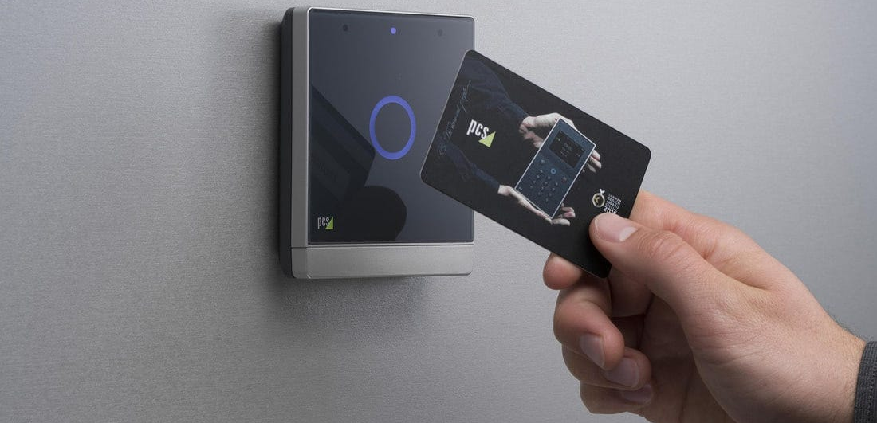

RFID SMART DOOR LOCKING SYSTEM

Slide 2
INTRODUCTION TO RFID TECHNOLOGY
RFID - Radio Frequency Identification technology. It is a wireless communication technology that uses radio waves to transmit data between an RFID reader and an electronic tag attached to an object.

Slide 3
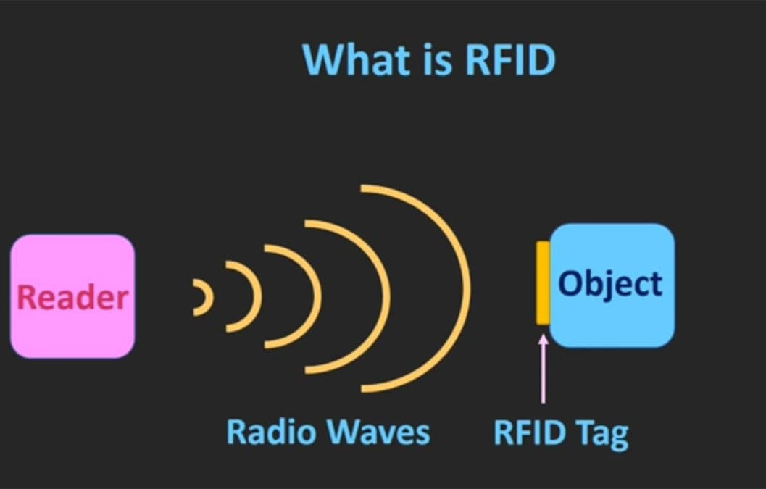

An RFID system consists of two main components:
>RFID reader
>RFID tag
The reader emits a radio signal that activates the tag and allows it to send back information. RFID technology can be used in a variety of applications, including inventory management, asset tracking, access control, and contactless payment systems.
How RFID Technology Works

Slide 4
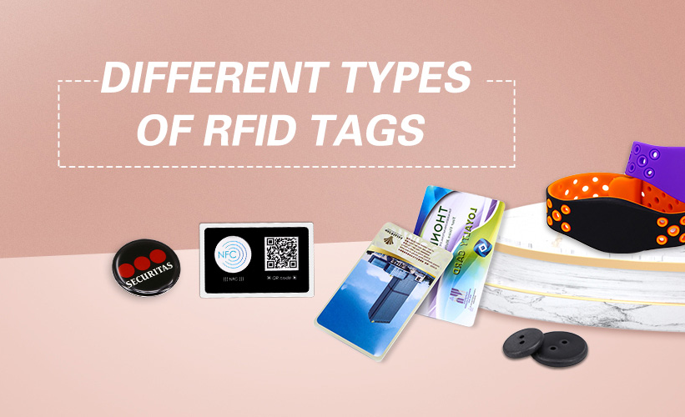

There are two main types of RFID tags:
>Passive
>Active
Passive tags do not have their own power source and rely on the energy transmitted by the reader to operate. Active tags, on the other hand, have their own battery and can transmit signals over longer distances.
RFID tags can also be classified based on their frequency range - Low-frequency tags and High-frequency tags.
Types of RFID Tags

Slide 5
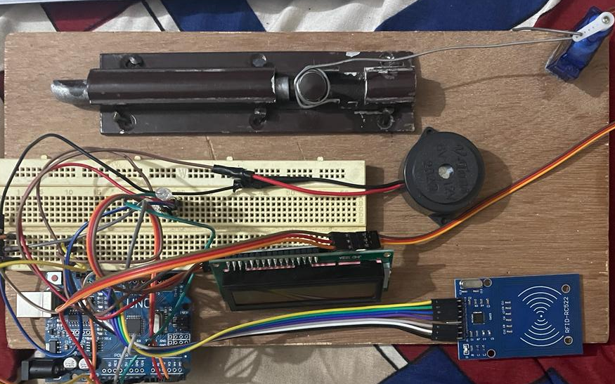
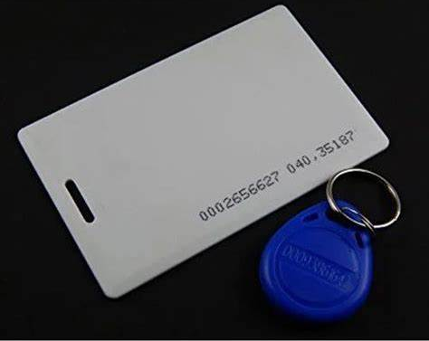
RFID SMART DOOR LOCKING SYSTEM
THIS IS A PROJECT (RFID SMART DOOR LOCKING SYSTEM) DONE A B.Tech STUDENT FROM Dr.Mahalingam college Pollachi

Slide 6

Let's Go!

